Slide 1
FY20 and FY21 PROFITABILITY ANALYSIS AND PROJECTIONS
LOYOLA UNIVERSITY, NEW ORLEANS

Slide 2
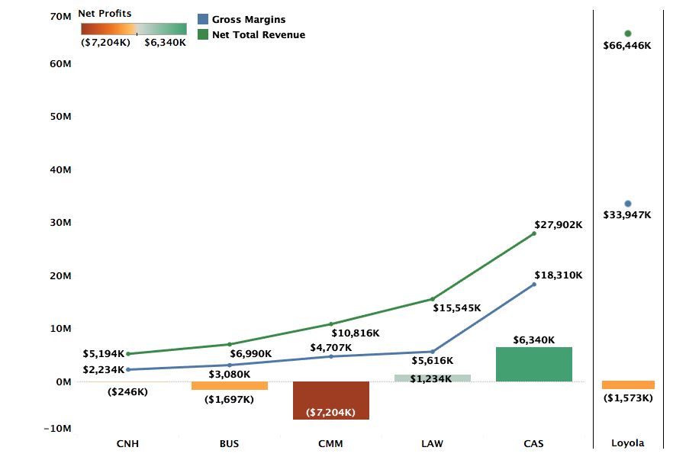
Profitability by College FY20 Actuals

Slide 3
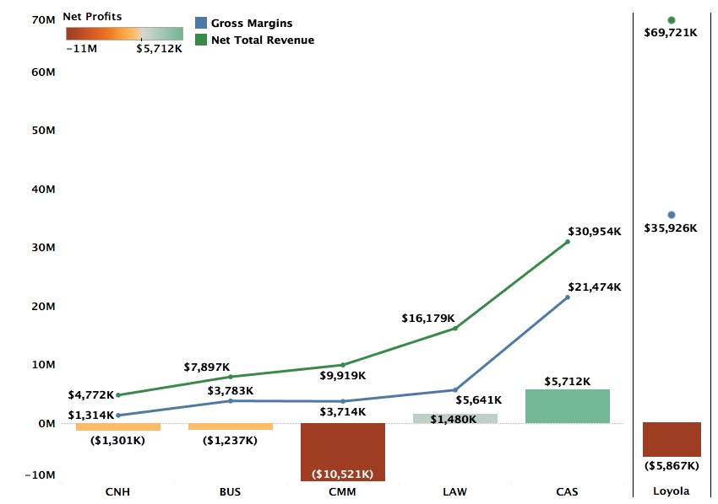
Profitability by College FY21 Projections

Slide 4
Profitability by Department (FY20 Actuals)
Excluding Classical Studies and Environment
Notes:
Departments like Teacher Certification and Studio art are small departments with low costs. They have +ve gross margins but higher profitability largely because of dorm revenue share which is divided by college and within college, the departments get equal share.

Slide 5
Profitability by Department (FY21 Projections)
Excluding Classical Studies and Environment
Notes:
Accounting is projected to be positive. All other 14 departments continue to be loss making. – Add the note on Accounting

Slide 6
DEFINITIONS
Net Total Revenue (NTR): NTR includes revenue for courses taught by the faculty of a department across all three terms, distributed revenue for courses that do not belong to a specific department, and distribution of revenues from courses of programs like Study Abroad that do not have any assigned faculty.
Gross Margins (GM): GM = NTR – Direct Costs. Direct costs include salaries, operating costs, and fringe benefits.
Profitability = GM – Indirect Costs + Indirect Revenues. Indirect costs refer to administration costs, auxiliary costs, or college level costs distributed over departments of the specific college. Indirect revenues include auxiliary revenues, dorm revenues, and revenue from other sources.

Slide 7
Methodology FY21 Projections
FY21 Revenue Projections: Revenue projections are based on Fall 2020 enrollments assuming the budgeted retention rate. FY20 summer revenues are used as proxy for the FY21 summer term.
Direct Costs: Direct costs include salaries and operating costs from department budgets. FY20 fringe benefits are used as a proxy for FY21 fringe benefits.
Indirect Costs: Indirect costs in FY20 and FY21 have been higher than previous years and is reflected in department-level profitability. FY21 is also estimated to bring in lower Auxiliary revenues.

Slide 8
DEPARTMENTS WITH DECLINING REVENUES/NEGATIVE GROSS MARGIN

Slide 9
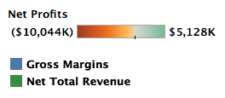
Music
GM for Music is projected to continue being negative with higher NTR and direct costs
Music accounted for 9.76% of students which is nearly 3 times the average size of a department
Given the size of the department, Music has more than twice the directs costs of an average department at the university
However, NTR for Music is only slightly above the department avg of ~$2.1M in FY20 and ~$2.2M in FY21, suggesting a high discount rate

Slide 10
Music Industry
Revenues and Gross Margins for Music Industry are projected to decline in FY21 despite a reduction in direct costs
Music Industry accounts for 9.7% of students which is nearly 3 times the average size of a department
The projected decline of ~$900K in profits is led largely by a ~$800K decline in NTR
Lower revenues also signify a higher than average discount rate

Slide 11
Communication
Despite higher than average NTR, revenues for Communication are projected to go down by ~$200K in FY21
The projected decline is driven by higher than average discount rates as at 7.4% of all students, Communication is more than twice the size of an average department
An overall decline in auxiliary and other revenues for the university contribute to further losses

Slide 12
Nursing
The projected decline in the NTR is worsened by a slight increase in direct costs which both result in ~$800K projected drop in gross margins and profits.
Nursing has above average projected NTR - ~$2.9M compared to university avg of ~$2.2M in FY21. However, direct costs of ~$2.2M is more than double the average direct costs of ~$1.1M.

Slide 13
DEPARTMENTS WITH CONSTANT REVENUES AND INCREASING LOSSES

Slide 14
Loyola Institute for Ministry
Despite a slight increase in projected revenues , LIM is projected to have lower GM due to a small increase in direct costs
Like Finance, LIM is projected to post an NTR of ~25% of an average department. However, its direct costs are ~50% of the direct costs of an average department at the university.

Slide 15
Psychology
Psychology accounted for 7.6% of all students in FY21 – that is 2.5 times the size of an average department. At ~$2.8M, Psychology accounts for only 1.25 times the average department revenue, suggesting a higher than average discount rate.

Slide 16
Biology
Biology had 5.9% of all students in FY20 – roughly twice the size of an average department. Its revenues are, however, proportionate to an average department suggesting higher than average discount rate

Slide 17
Theatre
The projected NTR and GM for FY21 are relatively constant compared to FY20
Indirect costs for Theatre are projected to increase from ~$1.3M in FY20 to ~1.5M in FY21
Auxiliary and Dorm revenues are projected to decrease from ~$650K to ~$500K

Slide 18
DEPARTMENTS WITH INCREASING REVENUES AND DECLINING LOSSES

Slide 19
Chemistry
Despite a projected slight increase in direct costs, a healthy projected increase in NTR for FY21 results in higher projected GM and lower losses.
GM is projected to improve by $332K in FY21 with losses dropping by $164K

Slide 20
Political Science
Political Science is projected to have better outcomes across the board in FY21
This is a direct result of increase in projected revenues by $153K
This is projected to result in an overall decline of $73K in losses

Slide 21
Management
A ~$300K increase in revenues is projected to result in ~120K increase in GM and ~$135K decrease in losses.
Management has 5.9% of all students at the university – roughly twice the size of an average department. However, it’s projected revenues of ~$3.3M are only 1.5 times the revenues of an average department, suggesting a higher than average discount rate.

Slide 22
Marketing
Healthy projected increase in NTR for Marketing is likely to reduce the losses for the department to $60K.
Despite a projected increase in revenues, Marketing has lower than proportionate NTR because of slightly higher discount rates

Slide 23
Finance
A slight increase in projected NTR is likely to improve the GM slightly and lower losses, but changes from FY20 to FY21 are projected to be minimal.
Finance is projected to only make ~33% of an average department’s NTR while accounting for 60% of direct costs for an average department.

Slide 24
Direct Costs to Revenue Ratio

Slide 25
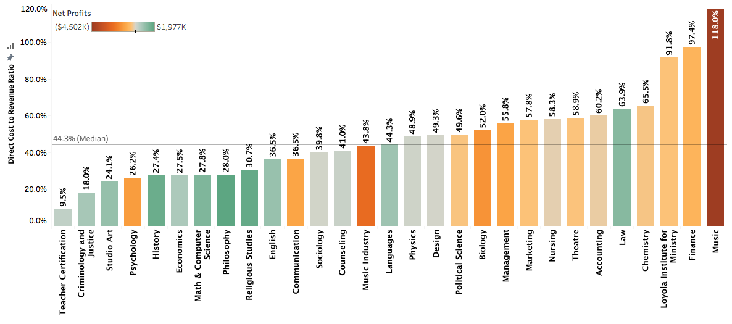
DCRR by Department (FY20 Actuals)
Excluding Classical Studies and Environment

Slide 26
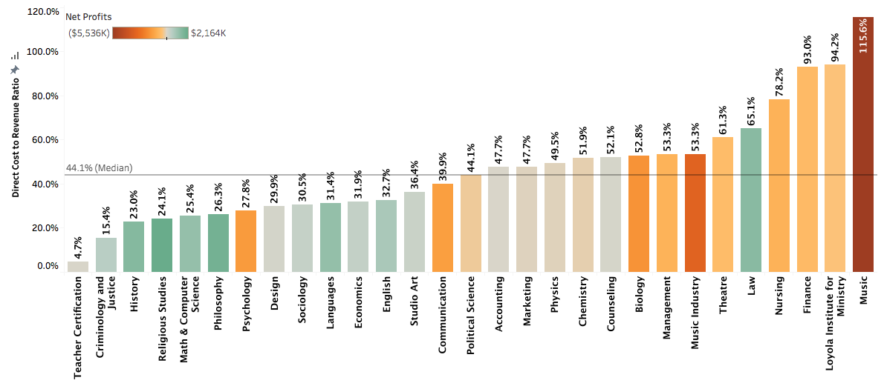
DCRR by Department (FY21 Projected)
Excluding Classical Studies and Environment

Slide 27
Summary and Recommendations
Higher indirect costs and lower auxiliary revenues because of coronavirus crisis are reflected in losses of some departments.
But losses are largely driven by either high discount rates or high direct costs.
High discount rates reflect the discounts offered to students taking courses offered by specific departments. These students may or may not be part of the majors offered by the departments. As such, driving lower discount rates should be a university wide initiative.
A separate analysis of discount rates by majors can be provided for each department.
Departments with higher than median DCRR have higher than proportionate direct costs or lower than proportionate revenues or a combination of both. For these departments the focus needs to be three-fold: improve enrollment, reduce discount rates, and reduce costs.

Slide 28
Appendix (FY19)

Slide 29
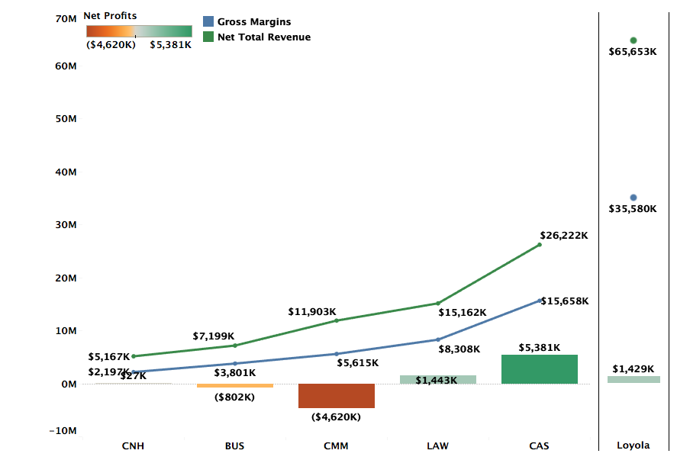
Profitability by College FY19 Actuals

Slide 30
Profitability by Department (FY19 Actuals)
Excluding Classical Studies and Environment
Notes:
Departments like Teacher Certification and Studio art are small departments with low costs. They have +ve gross margins but higher profitability largely because of dorm revenue share which is divided by college and within college, the departments get equal share.

Slide 31
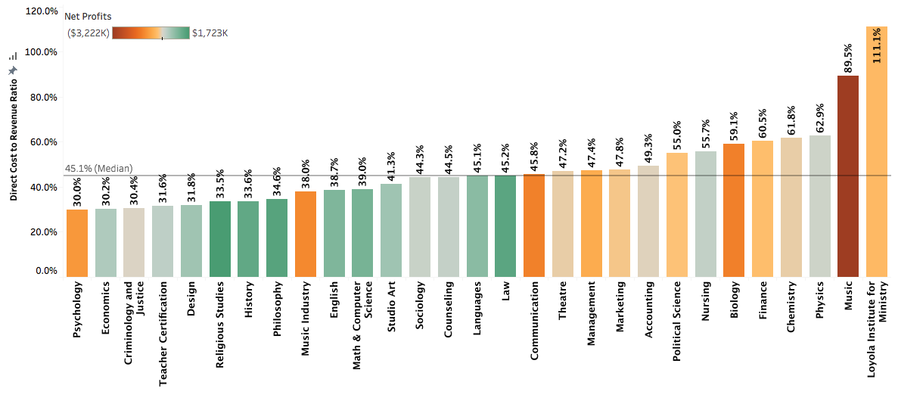
DCRR by Department (FY19 Actuals)
Excluding Classical Studies and Environment

